Slide 1
ISO27001:2013 Controls Appendix; Part 3
Lets continue to have a look at the ISO27001:2013 (ISMS) controls (appendix) in more detail…

Slide 2
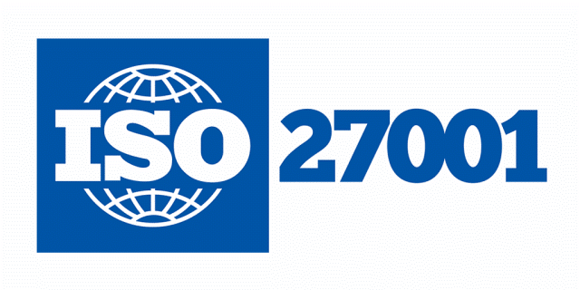
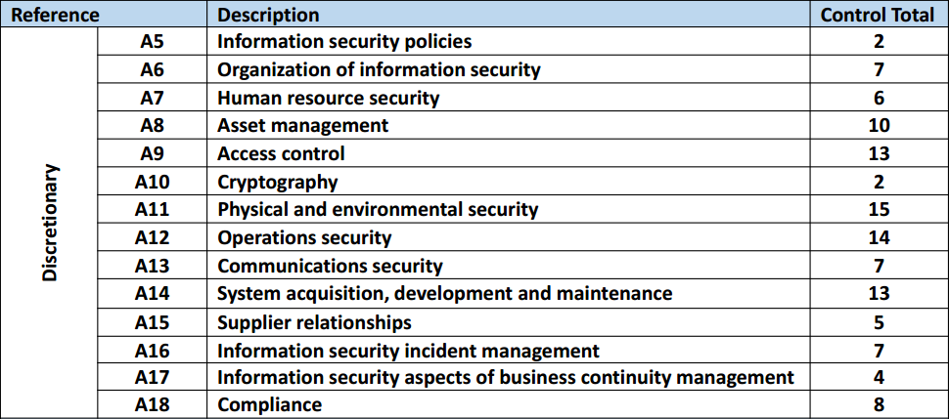
ISO27001:2013 Controls Appendix; Part 3
ISO27001:2013 DISCRETIONARY CONTROLS
TOTAL: 114
https://chapters.theiia.org/bermuda/Events/ChapterDocuments/Information%20Security%20Management%20System%20%28ISMS%29%20Overview.pdf

Slide 3
ISO27001:2013 Controls Appendix; Part 3
A.8 ASSET MANAGEMENT
A.8.1 RESPONSIBILITY FOR ASSETS
A.8.1.1 | INVENTORY OF ASSETS
A.8.1.2 | OWNERSHIP OF ASSETS
A.8.1.3 | ACCEPTABLE USE OF ASSETS
A.8.1.4 | RETURN OF ASSETS

Slide 4
ISO27001:2013 Controls Appendix; Part 3
A.8 ASSET MANAGEMENT
A.8.1.1 | INVENTORY OF ASSETS | Control: Assets associated with information and information processing facilities shall be identified and an inventory of these assets shall be drawn up and maintained.

Slide 5
ISO27001:2013 Controls Appendix; Part 3
A.8 ASSET MANAGEMENT
A.8.1.3 | ACCEPTABLE USE OF ASSETS | Control: Rules for the acceptable use of information and of assets associated with information and information processing facilities shall be identified, documented and implemented.

Slide 6
ISO27001:2013 Controls Appendix; Part 3
A.8 ASSET MANAGEMENT
A.8.2 INFORMATION CLASSIFICATION
A.8.2.1 | CLASSIFICATION OF INFORMATION
A.8.2.2 | LABELLING OF INFORMATION
A.8.2.3 | HANDLING OF ASSETS

Slide 7
ISO27001:2013 Controls Appendix; Part 3
A.8 ASSET MANAGEMENT
A.8.2.1 | CLASSIFICATION OF INFORMATION | Control: Information shall be classified in terms of legal requirements, value, criticality and sensitivity to unauthorised disclosure or modification.

Slide 8
ISO27001:2013 Controls Appendix; Part 3
A.8 ASSET MANAGEMENT
A.8.2.3 | HANDLING OF ASSETS | Control: Procedures for handling assets shall be developed and implemented in accordance with the information classification scheme adopted by the organization.

Slide 9
ISO27001:2013 Controls Appendix; Part 3
A.8 ASSET MANAGEMENT
A.8.3 MEDIA HANDLING
A.8.3.1 | MANAGEMENT OF REMOVABLE MEDIA
A.8.3.2 | DISPOSAL OF MEDIA
A.8.3.3 | PHYSICAL MEDIA TRANSFER

Slide 10
ISO27001:2013 Controls Appendix; Part 3
A.8 ASSET MANAGEMENT
A.8.3.1 | MANAGEMENT OF REMOVABLE MEDIA | Control: Procedures shall be implemented for the management of removable media in accordance with the classification scheme adopted by the Organization.

Slide 11
ISO27001:2013 Controls Appendix; Part 3
A.8 ASSET MANAGEMENT
A.8.3.3 | PHYSICAL MEDIA TRANSFER | Control: Media containing information shall be protected against unauthorized access, misuse or corruption during transportation

Slide 12
ISO27001:2013 Controls Appendix; Part 3
Lets look at access control in the next module…
END

